Slide 1



Understanding Organizations As Customers

Slide 2
LEARNING OBJECTIVES (LO) AFTER READING CHAPTER 5, YOU SHOULD BE ABLE TO:
1. Distinguish among industrial, reseller, and government organizational markets.
2. Describe the key characteristics of organizational buying that make it different from consumer buying.
3. Explain how buying centers and buying situations influence organizational purchasing.
4. Recognize the importance and nature of online buying in industrial, reseller, and government organizational markets.

Slide 3


BUYING IS MARKETING, TOO! PURCHASING PUBLICATION PAPER FOR JC PENNEY
JC Penney
Website

Slide 4

BUSINESS-TO-BUSINESS MARKETING AND ORGANIZATIONAL BUYERS
Business-to-Business Marketing
Organizational Buyers
Industrial Markets (Industrial Firms)
Reseller Markets (Resellers)
Wholesalers
Retailers
Government Markets (Government Agencies)
NASA

Slide 5
MEASURING DOMESTIC AND GLOBAL INDUSTRIAL, RESELLER, AND GOVERNMENT MARKETS
North American Industry Classification System (NAICS)
North American Free Trade Agreement (NAFTA)
NAICS
Web Site
NAFTA
Web Site

Slide 6
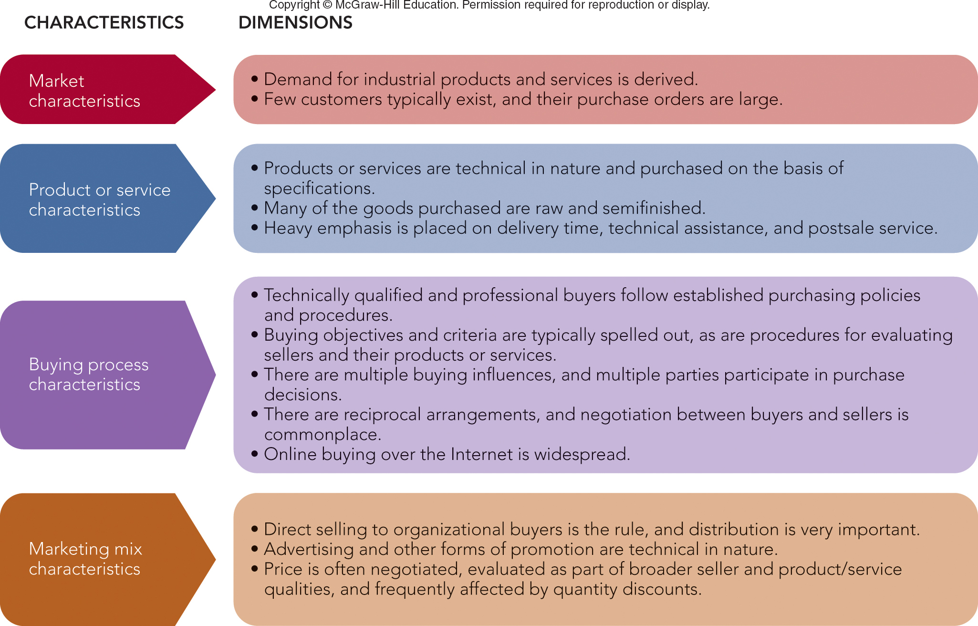
FIGURE 5-1 Key characteristics and dimensions of organizational buying behavior.
Jump to Appendix 1 long image description

Slide 7

ORGANIZATIONAL BUYING DEMAND CHARACTERISTICS
Derived Demand
Size of Order or Purchase
Number of Potential Buyers
Organizational Buying Objectives
Profits
Women/Minority Suppliers/Vendors
Efficiency
Environment/Sustainability

Slide 8

CHARACTERISTICS OF ORGANIZATIONAL BUYING ORGANIZATIONAL BUYING CRITERIA
LO 5-2
Organizational Buying Criteria
Supplier Development

Slide 9
FIGURE 5-A Key Organizational Buying Criteria
Profit Responsibility
Warranty/Claim Policies
Technical Capabilities
Price
Quality Specifications
Delivery Schedules
Past Performance
Product Facilities/Capacity
Jump to Appendix 2 long image description

Slide 10
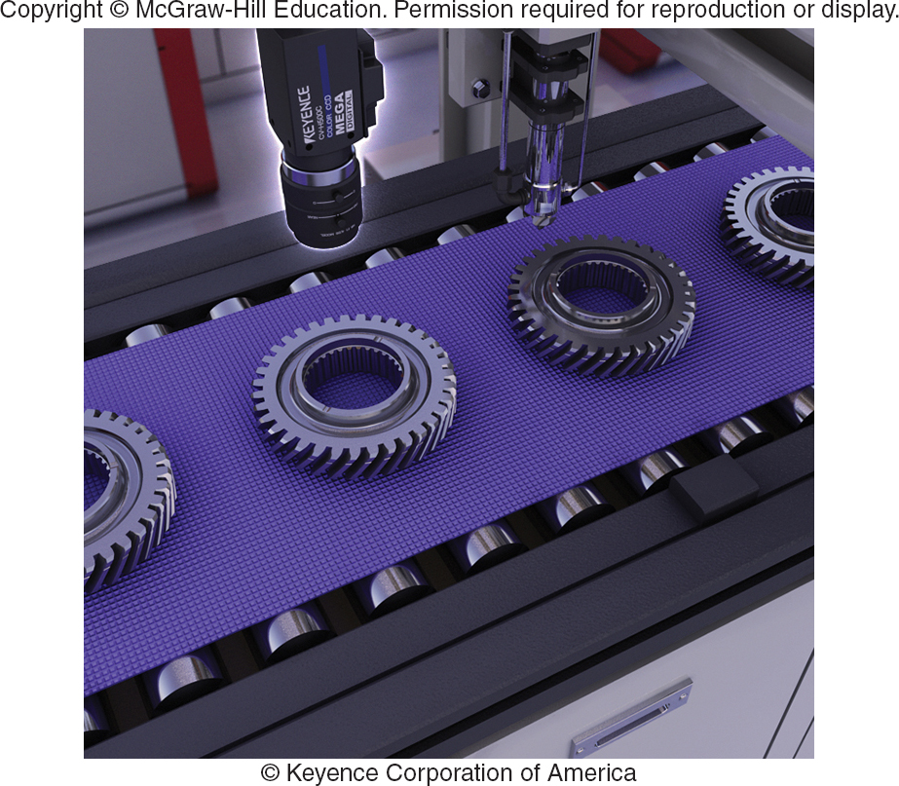
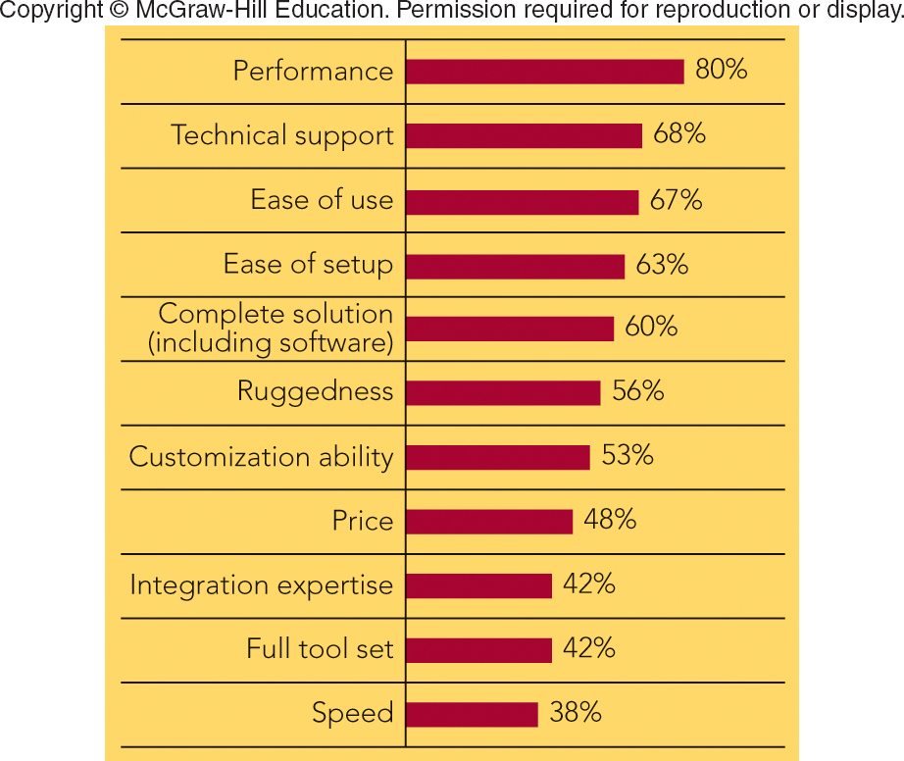
FIGURE 5-2 Product and supplier selection criteria for buying machine vision equipment emphasize factors other than price.
Machine vision inspection camera used in auto industry to perform a gear inspection
Percentage of machine vision buyers citing individual selection criteria as important when making supplier decision
Jump to Appendix 3 long image description

Slide 11
CHARACTERISTICS OF ORGANIZATIONAL BUYING BUYER-SELLER RELATIONSHIPS & SUPPLY PARTNERSHIPS
Reciprocity
Supply Partnership
Sustainable Procurement – To Benefit the Environment

Slide 12

MARKETING MATTERS Milsco Manufacturing—Delivering a Great Ride for Customers’ Seats
3 Million Seats
200 Unique Variations
84-Year Partnership with Harley-Davidson
100 New Products/Year to Meet Customer Requirements
Milsco Website

Slide 13

MAKING RESPONSIBLE DECISIONS Sustainable Procurement for Sustainable Growth
Starbucks Is a Leader in Sustainable Procurement
Coffee Growers in 20 Countries
Fair Price for Beans
Ecologically Sound Growing
Starbucks
Sustainability

Slide 14
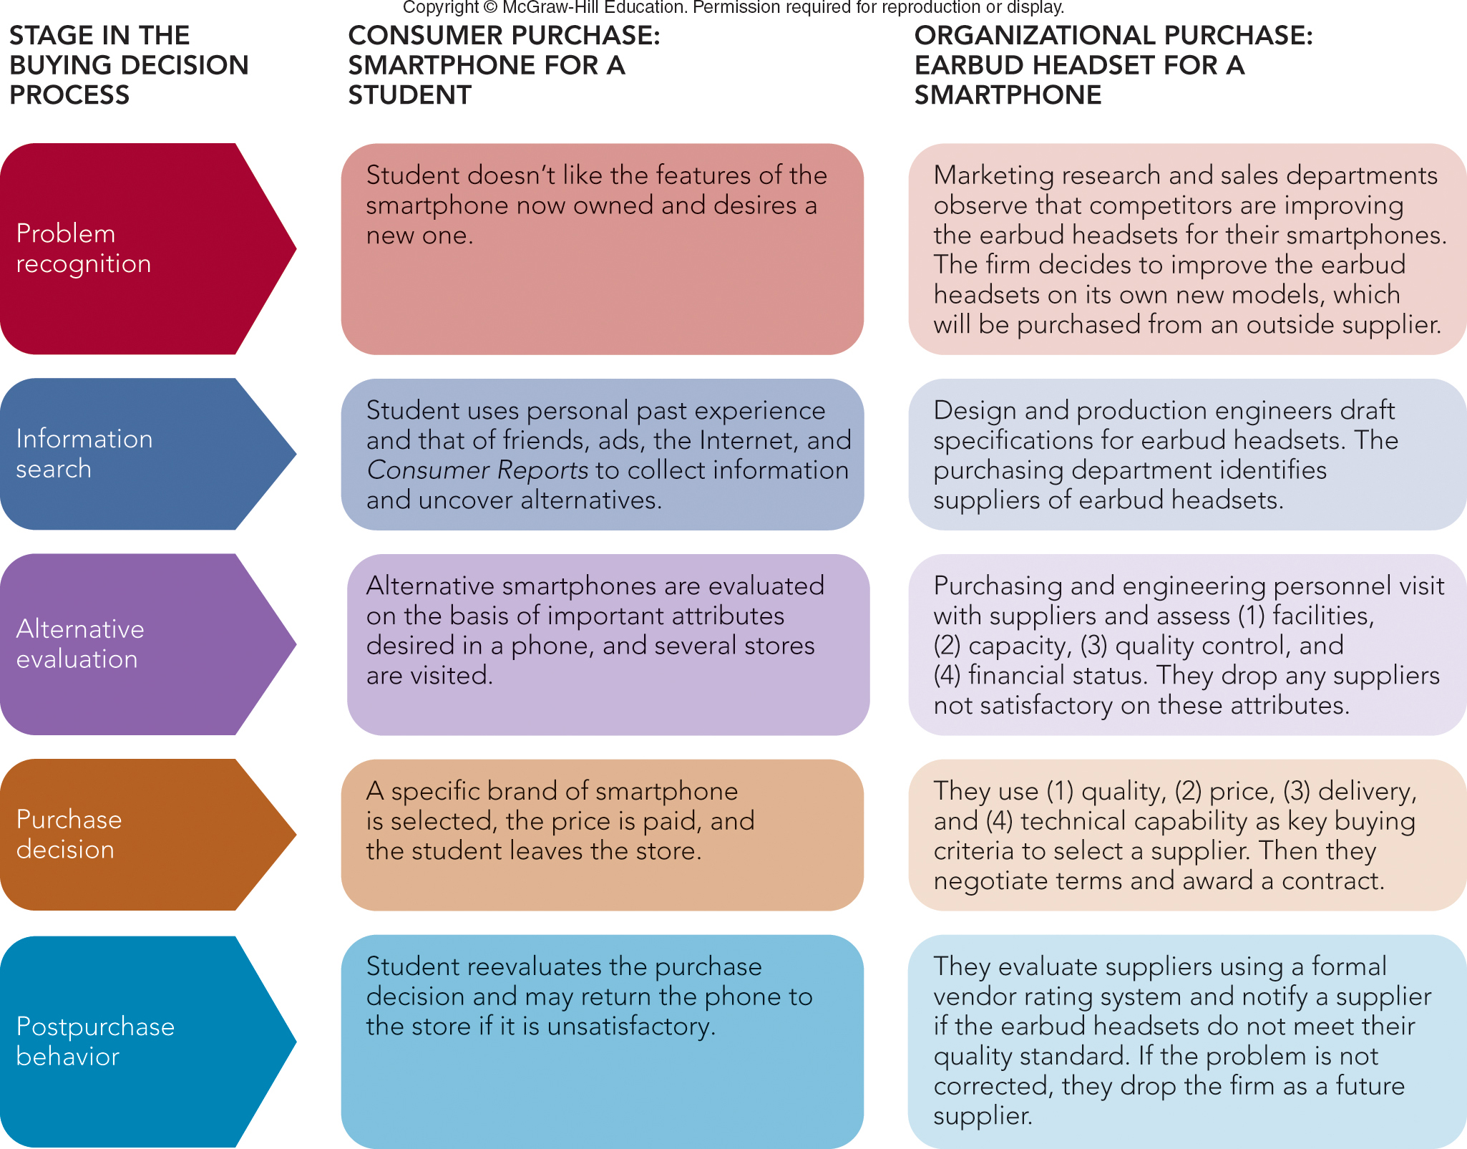
FIGURE 5-3 Comparing the stages in a consumer and organizational purchase decision process.
Jump to Appendix 4 long image description

Slide 15

ORGANIZATIONAL BUYING PROCESS AND THEY BUYING CENTER
Buying Center
Buying Committee
People in the Buying Center
Roles in the Buying Center
Users
Influencers
Buyers
Deciders
Gatekeepers

Slide 16
CHARACTERISTICS OF ORGANIZATIONAL BUYING THE BUYING CENTER
Number of People in Buying Center Depends on the Buying Situation
Buy Classes
New Rebuy
Straight Rebuy
Modified Rebuy

Slide 17
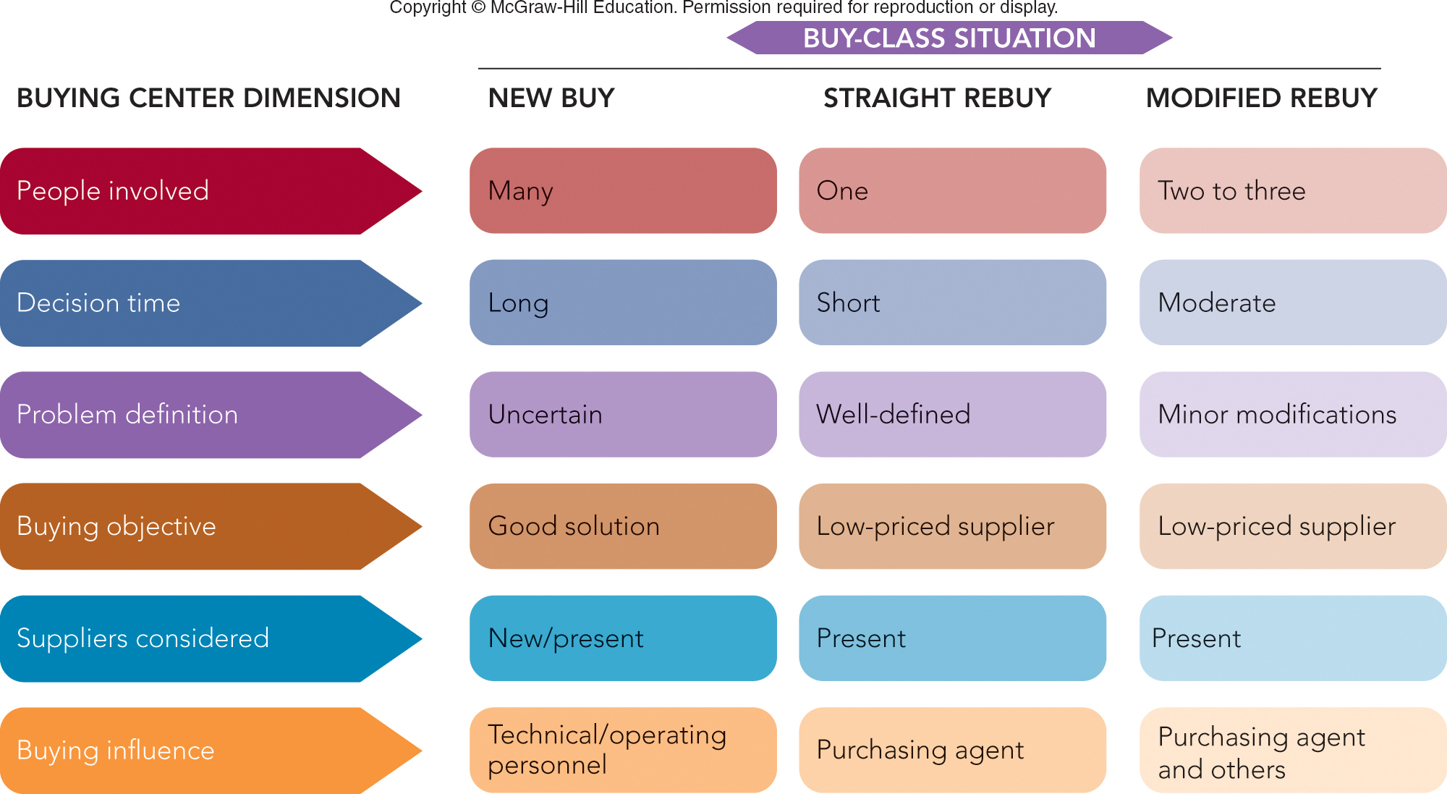
FIGURE 5-4 The buying situation affects buying center behavior in different ways.
Jump to Appendix 5 long image description

Slide 18
ONLINE BUYING IN BUSINESS-TO-BUSINESS MARKETING
Prominence of Online Buying in Organizational Markets
E-marketplaces
Online Auctions in Organizational Markets
Traditional Auction
Reverse Auction

Slide 19
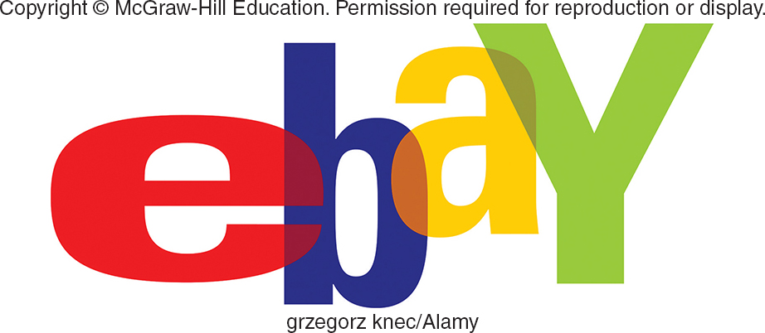
MARKETING MATTERS eBay Means Business for Entrepreneurs
eBay Website
81% of Small Businesses Sell to 5+ Countries
82% Report It Helped Business Grow
78% Reduced Costs
79% Became More Profitable

Slide 20
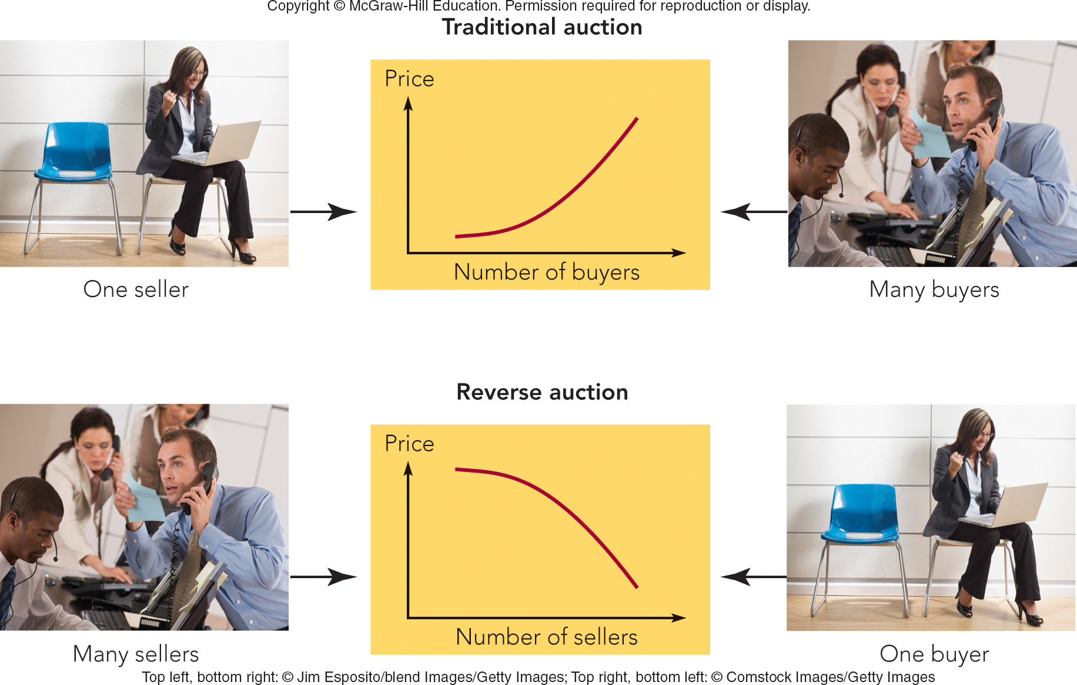
FIGURE 5-5 How buyer and seller participants and price behavior differ by type of online auction.
Jump to Appendix 6 long image description

Slide 21

VIDEO CASE 6 TREK: BUILDING BETTER BIKES THROUGH ORGANIZATIONAL BUYING
Trek Video
Case

Slide 22
VIDEO CASE 6 Trek (1 of 4)
What is the role of the buying center at Trek? Who is likely to comprise the buying center in the decision to select a new supplier at Trek?

Slide 23
VIDEO CASE 6 Trek (2 of 4)
What selection criteria does Trek utilize when it selects a new supplier or evaluates an existing supplier?

Slide 24
VIDEO CASE 6 Trek (3 of 4)
How has Trek’s interest in the environmental impact of its business influenced its organizational buying process?

Slide 25
VIDEO CASE 6 Trek (4 of 4)
Provide an example of each of the three buying situations—straight rebuy, modified rebuy, and new buy—at Trek.

Slide 26
IN-CLASS ACTIVITY 5-1
DAKTRONICS: REACHING AN ORGANIZATION’S BUYING CENTER

Slide 27
ICA 5-1 Daktronics: Buying Process
Example: Daktronics Products Reaching an Organization’s Buying Center
Dakronics Ad

Slide 28
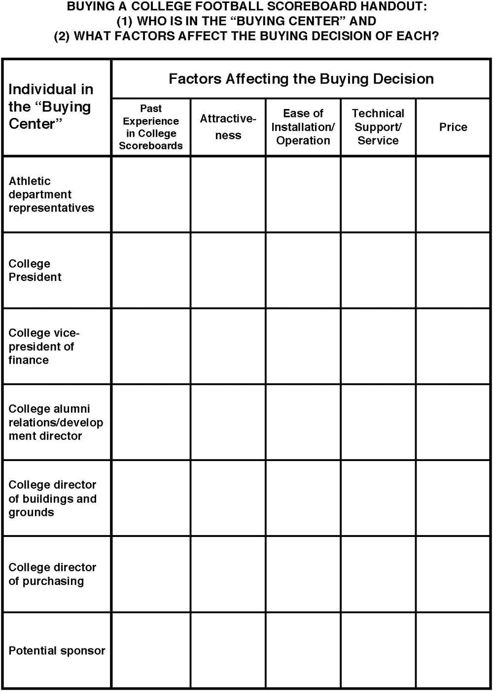
Daktronics handout

Slide 29
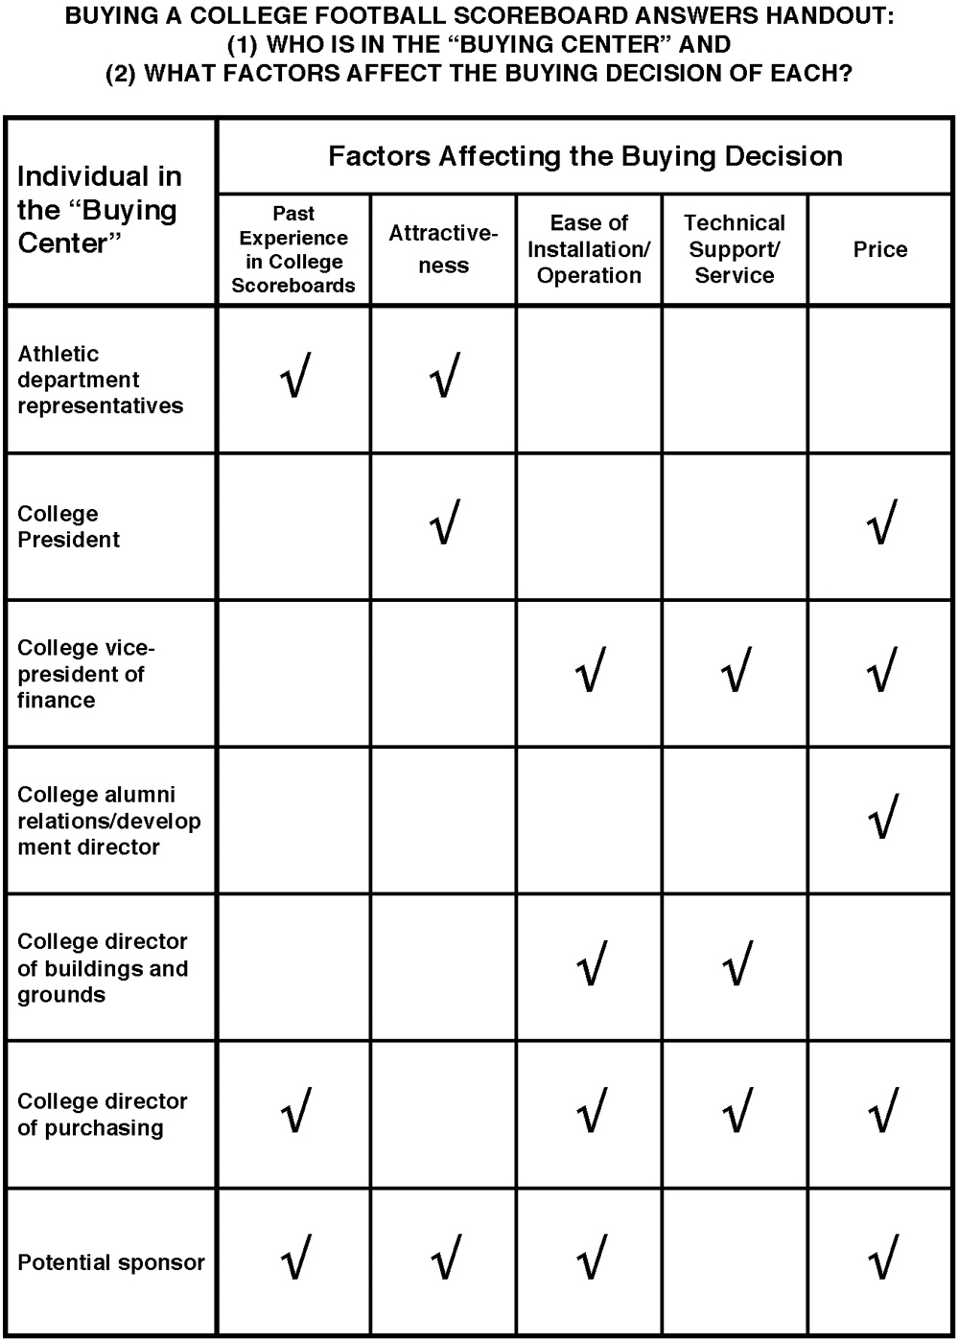
Daktronics answers handout

Slide 30


Business-to-Business Marketing
Business-to-business marketing involves the marketing of products and services to companies, governments, or not-for-profit organizations for use in the creation of goods and services that they can produce and market to others.

Slide 31
Organizational Buyers
Organizational buyers are those manufacturers, wholesalers, retailers, and government agencies that buy goods and services for their own use or for resale.

Slide 32
North American Industry Classification System (NAICS)
The North American Industry Classification System (NAICS) provides common industry definitions for Canada, Mexico, and the United States, which makes it easier to measure economic activity in the three member countries of the North American Free Trade Agreement (NAFTA).

Slide 33
Derived Demand
Derived demand is the demand for industrial products and services that is driven by, or derived from, the demand for consumer products and services.

Slide 34
Organizational Buying Criteria
Organizational buying criteria are the objective attributes of the supplier’s products and services and the capabilities of the supplier itself.

Slide 35
Supplier Development
Supplier development is the deliberate effort by organizational buyers to build relationships that shape suppliers’ products, services, and capabilities to fit a buyer’s needs and those of its customers.

Slide 36
Reciprocity
Reciprocity is an industrial buying practice in which two organizations agree to purchase each other’s products and services.

Slide 37
Supply Partnership
A supply partnership is a relationship that exists when a buyer and its supplier adopt mutually beneficial objectives, policies, and procedures for the purpose of lowering the cost or increasing the value of products and services delivered to the ultimate consumer.

Slide 38
Buying Center
A buying center consists of the group of people in an organization who participate in the buying process and share common goals, risks, and knowledge important to a purchase decision.

Slide 39
Buy Classes
Buy classes consist of three types of organizational buying situations: straight rebuy, new buy, and modified rebuy.

Slide 40
E-marketplaces
E-marketplaces are online trading communities that bring together buyers and supplier organizations to make possible the real time exchange of information, money, products, and services. Also called B2B exchanges or e-hubs.

Slide 41
Traditional Auction
A traditional auction, in an e-marketplace, is an online auction in which a seller puts an item up for sale and would-be buyers are invited to bid in competition with each other.

Slide 42
Reverse Auction
A reverse auction, in an e-marketplace, is an online auction in which a buyer communicates a need for a product or service and would-be suppliers are invited to bid in competition with each other.

Slide 43
Appendix 1 FIGURE 5-1 Key characteristics and dimensions of organizational buying behavior
Market characteristics: demand for industrial products and services is derived; few customers typically exist, and their purchase orders are large.
Product or service characteristics: products or services are technical in nature and purchased on the basis of specifications; many of the goods purchased are raw and semi finished; heavy emphasis is placed on delivery time, technical assistance, and post sale service.
Buying process characteristics: technically qualified and professional buyers follow established purchasing policies and procedures; buying objectives and criteria are typically spelled out, as are procedures for evaluating sellers and their products or services; there are multiple buying influences, and multiple parties participate in purchase decisions; there are reciprocal arrangements, and negotiation between buyers and sellers is commonplace; online buying over the Internet is widespread.
Marketing mix characteristics: direct selling to organizational buyers is the rule, and distribution is very important; advertising and other forms of promotion are technical in nature; price is often negotiated, evaluated as part of broader seller and product/service qualities, and frequently affected by quantity discounts.
Return to slide

Slide 44
Appendix 2 FIGURE 5-A Key Organizational Buying Criteria
Warranty/claim policies, technical capabilities, price, quality specifications, delivery schedules, past performance, and product facilities/capacity all lead to profit responsibility.
Return to slide

Slide 45
Appendix 3 FIGURE 5-2 Product and supplier selection criteria for buying machine vision equipment emphasize factors other than price.
The following criteria is important to machine vision buyers: performance (80 percent), technical support (68 percent), ease of use (67 percent), ease of setup (63 percent), complete solution including software (60 percent), ruggedness (56 percent), customization ability (53 percent), price (48 percent), integration expertise (42 percent), full tool set (42 percent), speed (38 percent).
Return to slide

Slide 46
Appendix 4 FIGURE 5-3 Comparing the stages in a consumer and organizational purchase decision process
The five stages of the buying decision process are listed, along with how each applies to a consumer purchase (a smartphone for a student) and a organizational purchase (an earbud headset for a smartphone).
1. Problem recognition. Consumer purchase: student doesn't like the features of the smartphone now owned and desires a new one. Organizational purchase: marketing research and sales departments observe that competitors are improving the earbud headsets for their smartphones. The firm decides to improve the earbud headsets on its own new models, which will be purchased from an outside supplier.
2. Information search. Consumer purchase: student uses personal past experience and that of friends, ads, the Internet, and Consumer Reports to collect information and uncover alternatives. Organizational purchase: design and production engineers draft specifications for earbud headsets. The purchasing department identifies suppliers of earbud headsets.
3. Alternative evaluation. Consumer purchase: Alternative smartphones are evaluated on the basis of important attributes desired in a phone, and several stores are visited. Organizational purchase: purchasing and engineering personnel visit with suppliers and assesses (1) facilities, (2) capacity, (3) quality control, and (4) financial status. They drop any suppliers not satisfactory on these attributes.
4. Purchase decision. Consumer purchase: a specific brand of smartphone is selected, the price is paid, and the student leaves the store. Organizational purchase: they use (1) quality, (2) price, (3) delivery, and (4) technical capability as key buying criteria to select a supplier. Then they negotiate terms and award a contract.
5. Post purchase behavior. Consumer purchase: student reevaluates the purchase decision and may return the phone to the store if it is unsatisfactory. Organizational purchase: they evaluate suppliers using a formal vendor rating system and notify a supplier if the earbud headsets do not meet their quality standard. If the problem is not corrected, they drop the firm as a future supplier.
Return to slide

Slide 47
Appendix 5 FIGURE 5-4 The buying situation affects buying center behavior in different ways
The six buying center dimensions are listed, as well as how they are affected by three buy-class situations: new buy, straight rebuy, and modified rebuy.
1. People involved. New buy: many. Straight rebuy: one. Modified rebuy: Two to three.
2. Decision time. New buy: long. Straight rebuy: short. Modified rebuy: moderate.
3. Problem definition. New buy: uncertain. Straight rebuy: well-defined. Modified rebuy: minor modifications.
4. Buying objective. New buy: good solution. Straight rebuy: low-priced supplier. Modified rebuy: low-priced supplier
5. Suppliers considered. New buy: new/present. Straight rebuy: present. Modified rebuy: present.
6. Buying influence. New buy: technical/operating personnel. Straight rebuy: purchasing agent. Modified rebuy: purchasing agent and others.
Return to slide

Slide 48
Appendix 6 FIGURE 5-5 How buyer and seller participants and price behavior differ by type of online auction
A line graph, labeled “price” on its vertical axis and “number of buyers” on its horizontal axis, shows an inclining curve in a traditional auction where there is one seller and many buyers.
A line graph, labeled “price” on its vertical axis and “number of sellers” on its horizontal axis, shows an declining arch in a reverse auction where there are many sellers and one buyer.
Return to slide

